Slide 1

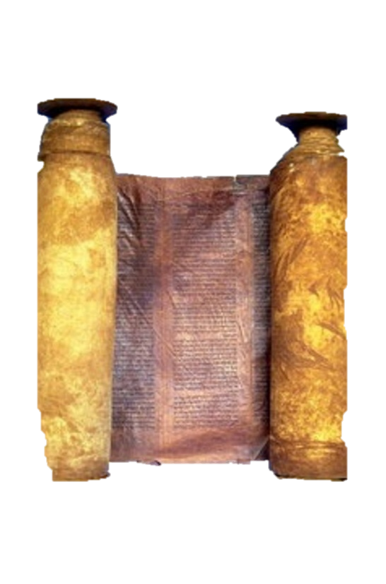




A free CD of this message will be available immediately following the service
2 Kings
5-7
A podcast will also be available later this week at calvaryokc.com

Slide 2



Josephus ~ “ … their king had commanded them; and when they sought to kill Ahab alone, but could not find him, there was a young nobleman belonging to king Ben Hadad, whose name was Naaman; he drew his bow against the enemy, and wounded the king through his breastplate, in his lungs.”
2 kings 5-7

Slide 3
2 kings 5-7

Slide 4
2 kings 5-7

Slide 5
2 kings 5-7

Slide 6
God's instructions are simple …
but against our nature
2 kings 5-7

Slide 7
2 kings 5-7

Slide 8
Float ~ KJV, did swim
2 kings 5-7

Slide 9
2 kings 5-7

Slide 10
Greatly troubled ~ storm-tossed, cycloned
2 kings 5-7

Slide 11
2 kings 5-7

Slide 12
He didn't pray for deliverance, but for eyes to see the deliverance
Heb. 11:27 ~ By faith he forsook Egypt, not fearing the wrath of the king; for he endured as seeing Him who is invisible.
2 kings 5-7

Slide 13
Faith:
Seeing is believing
World:
Believing is seeing
2 kings 5-7

Slide 14
2 kings 5-7

Slide 15
Calamity ~ KJV, evil
2 kings 5-7

Slide 16
2 kings 5-7

Slide 17
Kab of dove’s dung
= 5 Shekels
Seah of fine flour
= 1 Shekel
2 seahs of barley
= 1 Shekel
2 kings 5-7

Slide 18
2 kings 5-7

